Slide 1


HMIS Inclement Weather Shelter
Data Entry & Data Quality

Slide 2
Topics
  Privacy, Security, & Ethics Reminders
  Data Entry Process Reminders
  Deduplication of Client Records
  Data Elements Collected at IWS

Slide 3
Privacy, security, & ethics reminders
Emergency Shelter Night-by-Night Data

Slide 4

Privacy, Security & Ethics
You're working with sensitive client data
Access only what you need
Keep passwords secure
Never allow web browser to save your password
Never share Login Information
Log out when you're done
Never share client info outside approved channels
Report anything suspicious
Notes:
Credentials/System settings
We’re working with highly sensitive data, and it’s essential we treat it with the same care and caution as if it were our own.
Every step we take should prioritize both data security and the safety of the people we serve and work alongside.
Access only what you need
If someone you know may be in the system and you just want to see what they’ve got going on, don’t.
There is no reason to invade that person’s privacy
If they aren’t willing to share with you, you don’t need to know it
You should only be reviewing/updating/enrolling persons who are participants of or could potentially be a participant of your project or agency
When I say potential participant, I am specifically speaking to individuals who are referred to you or your agency via CAS
Keep passwords secure
If passwords are written down on paper, they need to be stored somewhere that has a lock
If passwords are saved in your notes on your phone, it needs to be password protected
Same goes for passwords you have saved in notes on your computer
Never allow your web browser to save your password
If your web browser (Chrome, Firefox or Microsoft Edge) ask if you want to save your password ALWAYS select no or never
These are things we check when completing on-site security reviews
Never share login information
Anyone who needs access to HMIS needs to go through the proper channels to gain access
Have them contact your agency’s HMIS Security Officer so they can get training
Maybe you have teammate asking to use your login information
They have an HMIS account, but they can’t login because they’re currently locked out
Tell them to contact their HMIS Data Quality Officer to have their password reset
It doesn’t matter if it’s your CEO
Do not share your username and password
Nor should you be logging in for them so they can access the system
Bottom line - it doesn’t matter who they are
If there’s ever a data breach, we will review all information surrounding that breach which includes login reports
Log out when you're done with the system or if you need to get something
We understand the system will log you out after 5 minutes of inactivity, but you need to make sure you logout before stepping away from your computer
5 minutes may seem short, but it’s plenty of time for a breach
Never share client info outside approved channels
We don’t have dedicated victim service providers in HMIS, but we do have agencies that serve persons fleeing from domestic violence situations
Protecting their privacy is not just a compliance issue; it’s a safety issue.
It is critical that we handle their information with the highest level of confidentiality to ensure their continued safety.
We also collaborate with agencies that serve highly vulnerable populations such as:
RHY (Runaway and Homeless Youth)
Individuals connected to HOPWA (Housing Opportunities for Persons With AIDS).
These populations require extra confidentiality due to their situations.
While you may not have full access to their enrollment details, you could encounter basic information in the system
Must be handled with strict care.
If someone asks you to share client information you need ensure they are someone who should have access to this information
If you are not sure if this person should have the information
Contact your supervisor
Contact us
You never know what someone is going to do with the information you give them
If you are contacted by someone requesting information on a specific person your response should be like one of the following:
Option 1:
I really appreciate you reaching out. However, to protect everyone’s privacy, we’re not able to confirm or share any information about individuals in our system. Even with family members. Unless we have permission from that person. This policy is in place to protect the safety and confidentiality of the people we serve.
Option 2:
I really appreciate you reaching out. That said, because of privacy laws and the way our system works, I’m not able to confirm whether someone is or isn’t receiving services here. Even for close family, we’re required to have permission from the person before sharing any information. What I can do is let you know about the services we offer and how someone can get connected to support. Talk with your loved one and if they choose to involve you directly, we’d be glad to talk at that point.
Report any suspicious activity or behavior
We can’t take action if you don’t bring it to our attention
If you observe any unusual behavior or actions that raise concerns:
Such as someone attempting to access data they don’t need for their role
Or someone pressing for information in a way that feels inappropriate, let us know immediately
Your vigilance helps protect everyone
Act as though your personal data is in this system

Slide 5
privacy notices & privacy policy
Privacy Notice:
Available on the website
Must be posted in a visible location wherever data is being collected
Must be posted in english and spanish
Privacy Policy:
Full text available on the website
Explains why data is collected and how it is used
Defines privacy standards for any organization utilizing hmis
Defines when and how Personally Identifiable information can be shared

Slide 6
Data Entry Process Reminders
Emergency Shelter Night-by-Night Data

Slide 7
Data Collection Process
At a glance
Steps | Reminders
Informed Consent/Privacy | Briefly explain that our system shares information with other service providers who are trained on how to keep their personal information private and they have the right to decline to answer any question
Search for Neighbor in ClientTrack | Use 2-3 letters of first and last name, confirm DOB or SSN to deduplicate If neighbor has active IWS enrollment, skip to Bed Night service
Enrollment | Complete HMIS Intake for neighbor and enroll them in IWS program. Use the job aid for data quality reminders on collecting certain data
Bed Night Service | Create a new service and record a Bed Night for the site you are working Confirm that you are recording the service for the correct date
Notes:
When it comes to the entry, update, annual, and exit assessments, make note of these additional considerations and reminders:
For your outreach program, you should enroll EVERY client, even if you only have an alias (nickname) or very little identifying information. Remember, until you record a date of engagement, the missing information will not affect your data quality report. The only other concern here would be duplication of clients, which we’ll discuss in just a moment. Don’t let worries about missing information or duplication of clients keep you from enrolling a client into your program.
Update assessments will likely be frequent, as you should record an update any time you client’s situation changes. This includes a change in current living situation, income, disability, or engagement. You will use this assessment or record the client’s date of engagement if the client is engaged any date after their project start date.
Annual Assessments are required for clients in street outreach programs. All of the regular data standards for annual assessments apply. Record them within the 60 day window surrounding the client’s anniversary of their project start date.
Exit assessments are also required and follow the regular data standards – meaning any client no longer being served by your program should be exited. Some street outreach programs may opt for auto-exits to be set up. You can ask your Data Quality Officer if your program uses auto-exits. The auto-exit is based on a timeframe that references the client’s most recent CLS. The timeframe is typically 90 days but may very. Using 90 days as an example, it would automatically record an exit date for a client who has not had a CLS recorded within the last 90 days. However, you should not rely on the auto-exit to complete your exit assessments. Auto-exits will have missing information in data quality reports. Even if your program is using auto-exits, you should still exit every client in the program.

Slide 8
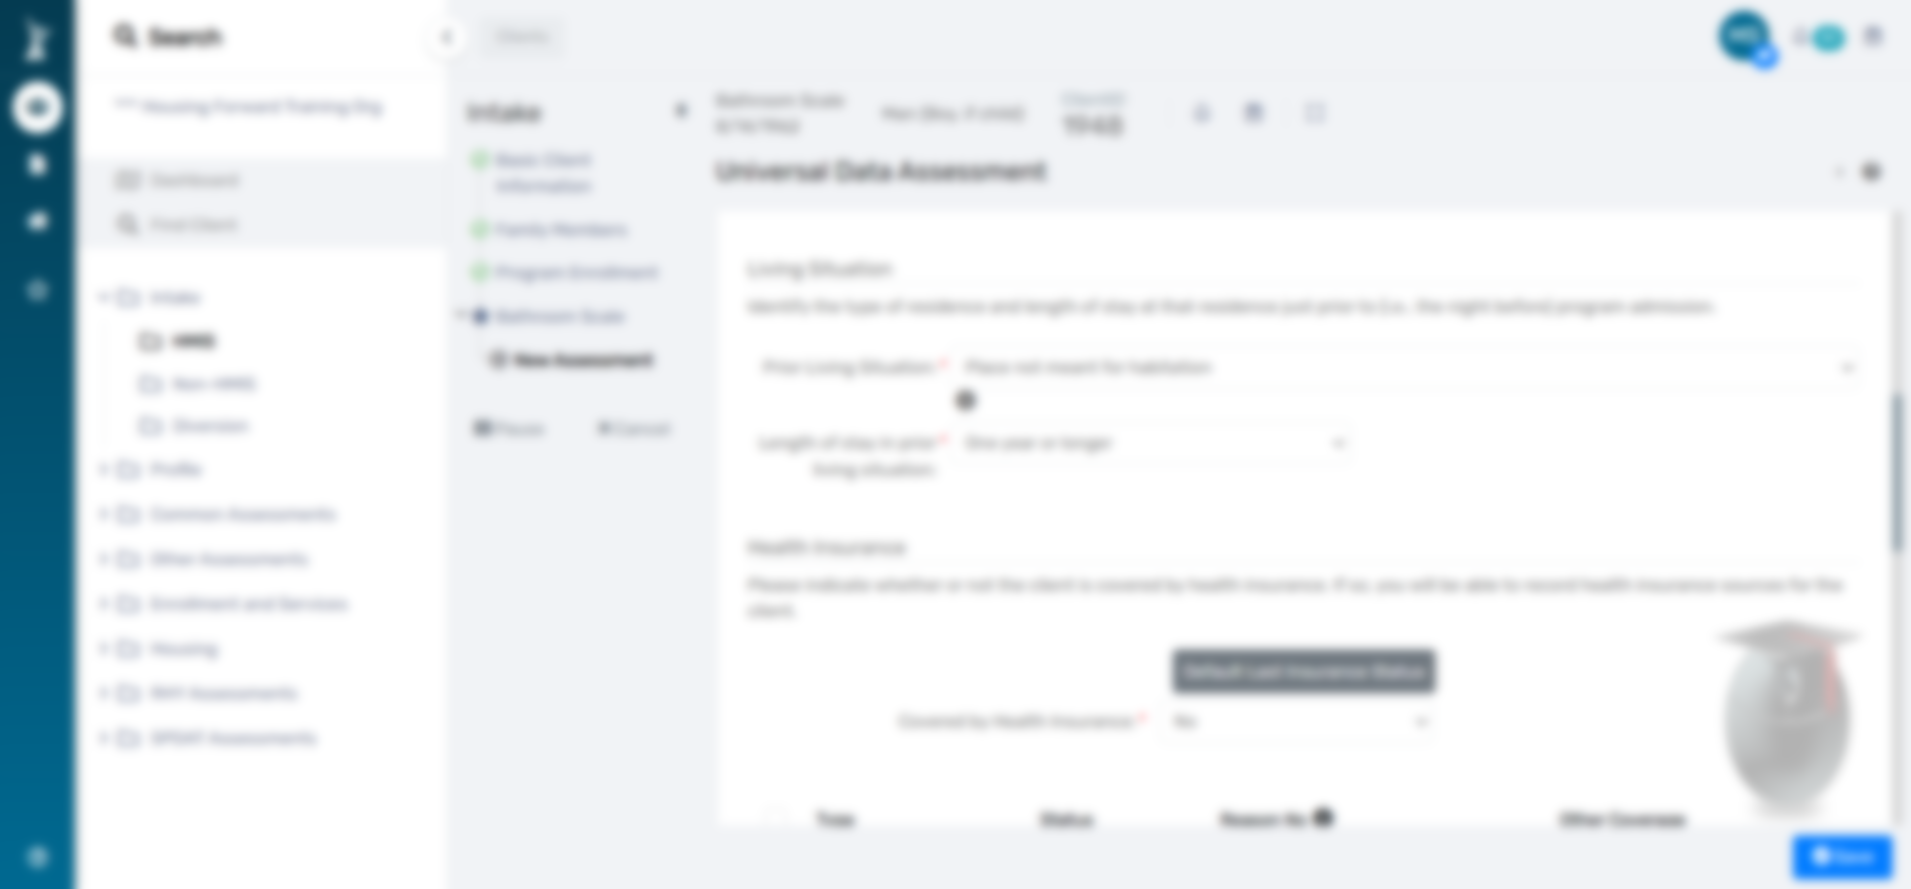
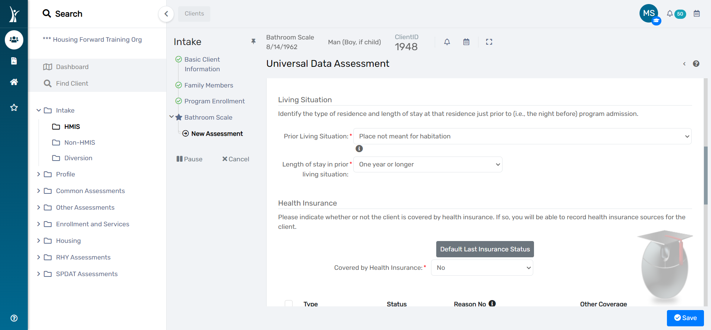

Pausing/Canceling Workflows
Use Sparingly

Slide 9
De-Duplication of Client REcords
Emergency Shelter Night-by-Night Data

Slide 10
HMIS Deduplication
Best practices to avoid duplication
If you find a duplicate client
  Search using only first 2-3 letters of first and last name
  Search in multiple ways
        Date of birth
        Only one name (first or last) + other initial
        Alias
  Search multiple spellings
  Swap first and last name
  Submit a help desk ticket with both client IDs
  HMIS admins will merge the records, and the client will keep their oldest ClientTrack client ID
If in doubt…
  Create a new client record and submit a ticket with both IDs immediately. The HMIS can review the data and make the best determination.
Notes:
Before we conclude, let’s briefly discuss duplication and deduplication of client’s records in HMIS.
While it is almost inevitable that clients served by street outreach programs may be entered into the system multiple times with duplicate records, there are steps you can take to avoid duplication as much as possible.
- search using the first 2-3 letters
Search in multiple ways (never all)
Search with multiple spellings
If you search and find multiple records of the same client, you can enter your data on the record with the smaller client ID. Then, submit a Spiceworks ticket to our HMIS admin team to ask them to look into the duplicate. Records will be merged and the client will retain the older (smaller) clientTrack client ID.
While our team regularly analyses records and merges duplicates, it is helpful for you to identify them via a Spiceworks ticket when you find them.
Finally, while duplicate records are problematic, they can be fixed with this relatively simply merge process. It is much more complicated to remove and correct data that was incorrectly recorded on the wrong client. So, if you are in doubt as to whether a record you found is in fact your client, just create a new record and make note of the old ID. You can always request the merge if you find out that you created a duplicate later on.

Slide 11
Data Elements Collected at iws
Emergency Shelter Night-by-Night Project Type

Slide 12
Data Elements Collected at iws
  Name
  Date of Birth
  SSN
  Sex
  Race & Ethnicity
  Veteran Status
  Project Start Date
  Disabling Condition
  Prior Living Situation
  Barriers
  Domestic Violence
  Current Living Situation
  Bed Night Services
  Date of Engagement
  Project Exit Date

Slide 13
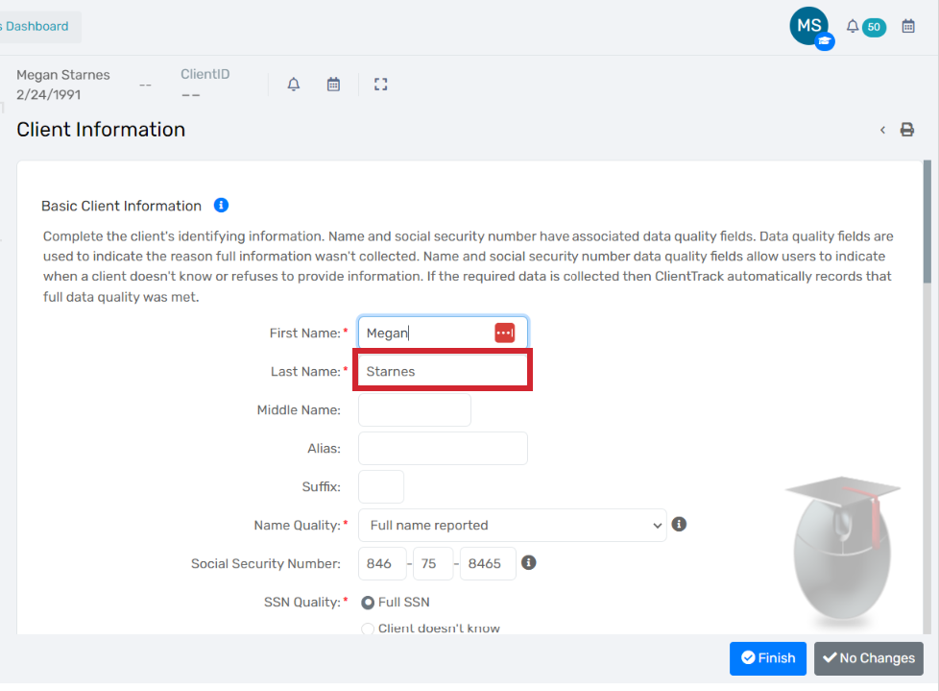
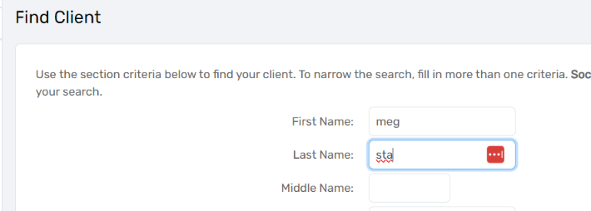
Name
  Ask for name and spelling of name always
  Search with first 2-3 letters
  Enter full names if possible

Slide 14
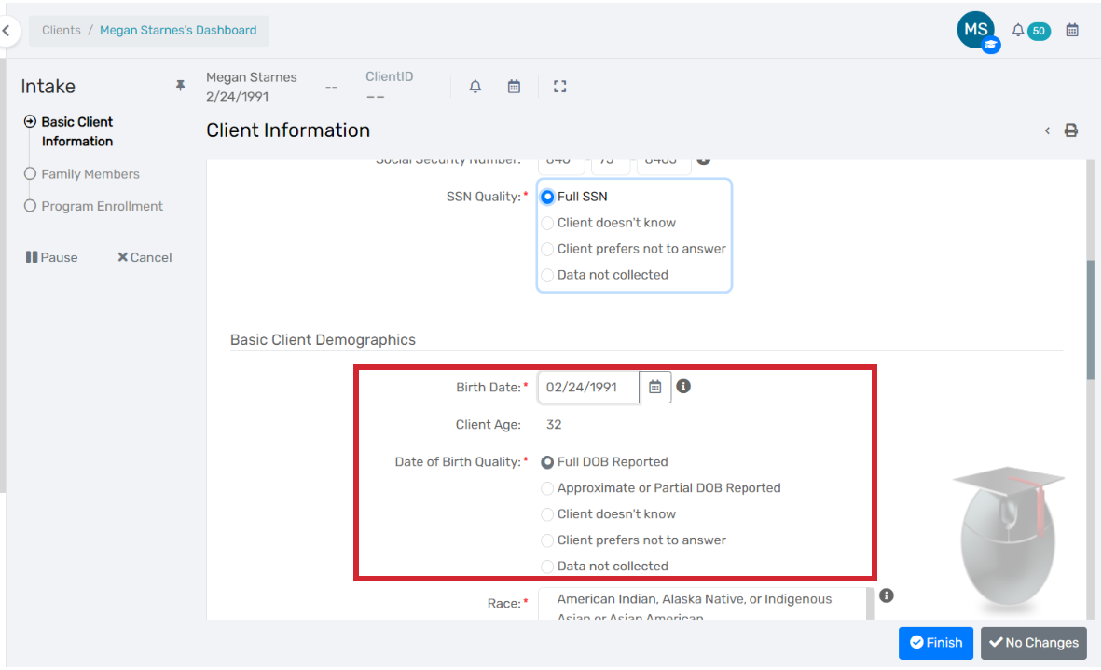
Date of birth
  Can search for a DoB in combo with initials to help find a neighbor
  Mainly to deduplicate clients and confirm you are speaking to the correct neighbor
  Confirm whether you are entering full or partial

Slide 15
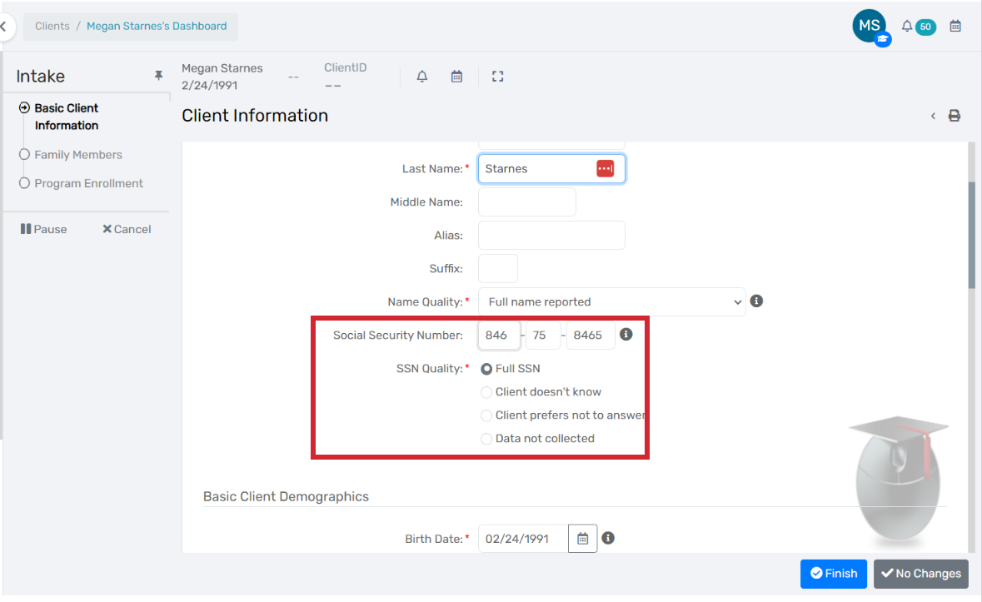
SSN
  Can search for last 4 of an SSN in combo with initials to help find a neighbor
  If existing client, confirm any SSN that is entered
  Never use filler digits for partial SSN

Slide 16
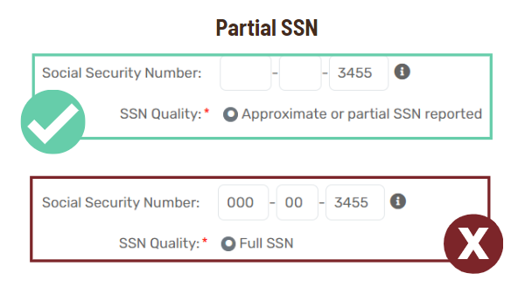
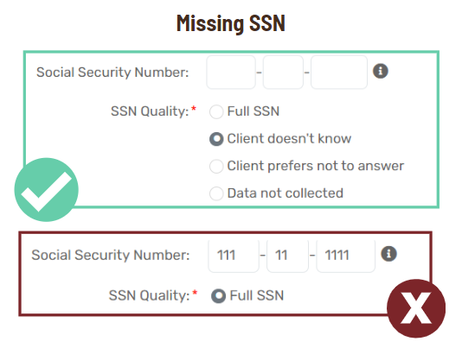
Recording Partial and Missing SSN

Slide 17
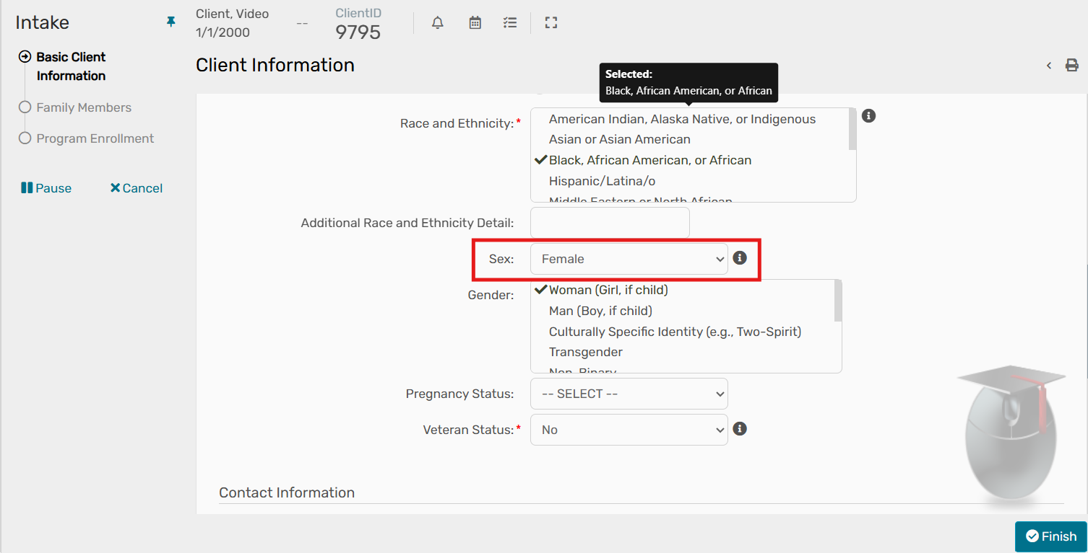
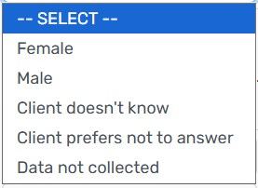
sex

Slide 18
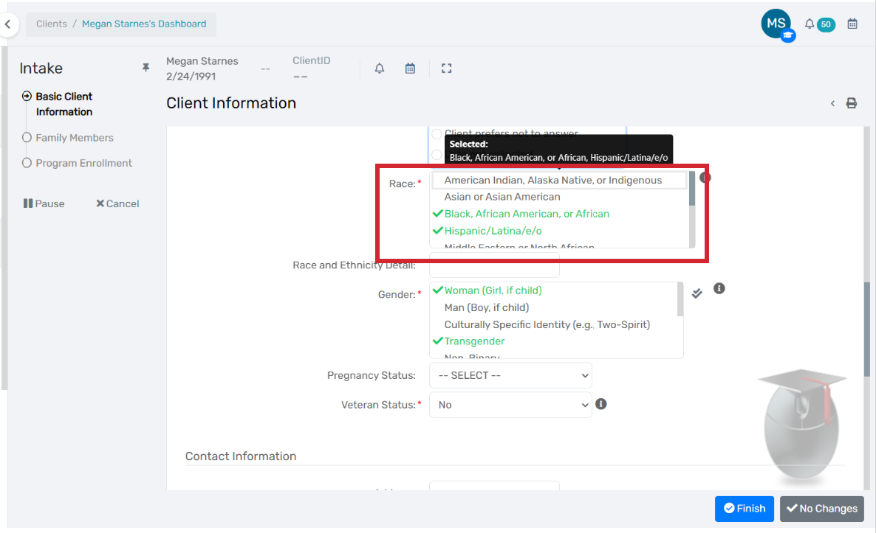
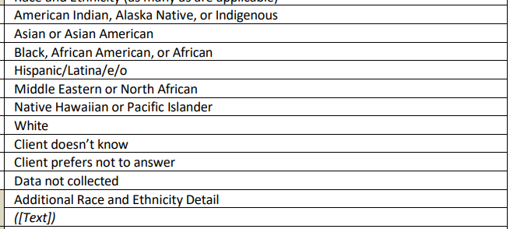
Race & Ethnicity
  Multiselect

Slide 19
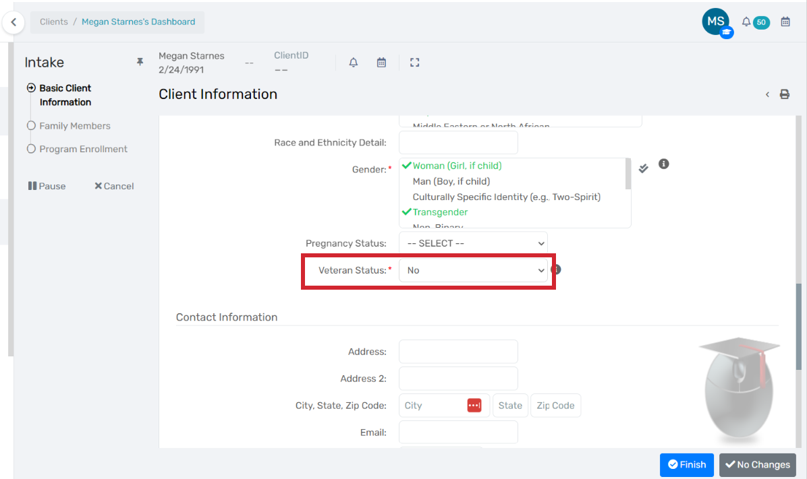
Veteran Status
  How to ask the question
  Why we ask the question – just a yes/no
“Have you actively served in any branch of the U.S. military including Space Force, National Guard, or Reserves?”

Slide 20
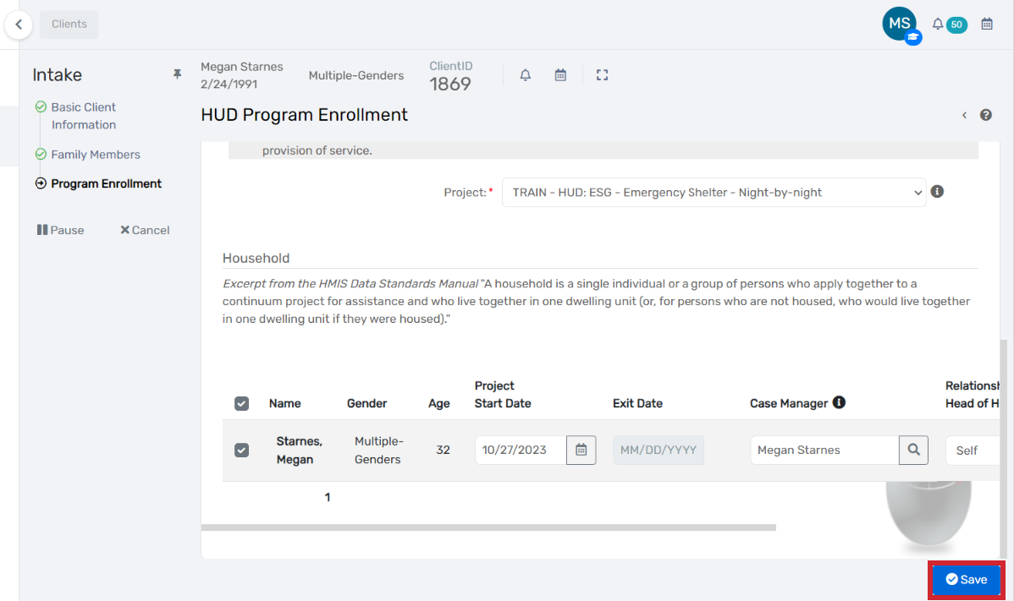
Project start date
  Day you are enrolling them
  Should not need to change often

Slide 21
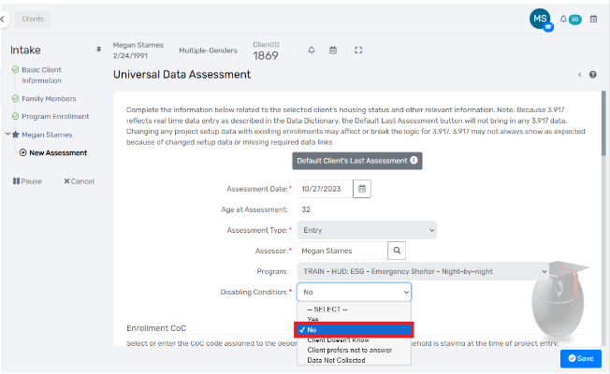
Disabling Condition
  Context is that this question might help us connect them to services and housing programs that better meet their needs depending on their answer.
  Do you have any ongoing or long-lasting physical or mental health conditions that make it hard to find or keep stable housing?

Slide 22
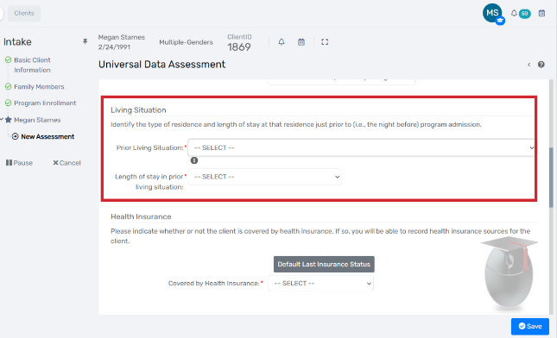
Prior Living Situation

Slide 23
Prior Living Situation
  Are you experiencing literal homelessness?
One “Data Element” that contains 5 questions, or pieces of information:
1) Prior Living Situation
Where did the client stay last night?
  Are you experiencing ongoing or episodic homelessness?
2) Length of Time
How long did they stay there?
3) Approx Date Homelessness Started
What was the first date of this episode of homelessness?
  How many episodes?
4) Number of Times Homeless in 3 Years
How many times have they experienced homelessness in the last 3 years?
  Are you experiencing chronic homelessness (more than 12 months)
5) Total Number of Months Homeless in 3 Years
How many total months have they experienced homelessness in the last 3 years?

Slide 24
Prior Living Situation
  Are you experiencing literal homelessness?
  Where did you stay last night?
  How many nights in a row did you stay there this time?
  Can you remember the last time (or most recent time) you stayed in a place that you or someone you know paid for? – lease, hotel, couch surfing, doubled up,
  How often do you do that? Or, between those times, where were you staying?
  In the last 3 years, would you say you’ve spent more or less than 12 months on the street or in shelter? If less, about how many altogether?
  Are you experiencing ongoing or episodic homelessness?
  How many episodes?
  Are you experiencing chronic homelessness (more than 12 months)

Slide 25
Prior Living Situation
Prior Living Situation: Where did you stay last night?
Length of Time: How many nights in a row did you stay there this time?
Approx. Date This Episode Started: Can you remember the last time (or most recent time) you stayed in a place that you or someone you know paid for?
# of Episodes: How often do you do that? Or, between those times, where were you staying?
Total # of Months: In the last 3 years, would you say you’ve spent more or less than 12 months on the street or in shelter? If less, about how many altogether?
SCENARIO 1
Jose has been homeless for several years and living on the streets in McKinney. He reports that he hasn’t stayed in one place for more than a few nights in the last two years. His homelessness has been ongoing and he can't recall the last time he stayed in a place that he or someone he knows paid for. He has rarely, if ever had a roof over his head in the last few years. If he has stayed in a place with a roof in the last few years, it has been a shelter, but that’s usually only when it’s cold.
Notes:
General takeaway: this person is experiencing continuous chronic homelessness. They can't remember any "breaks" in the last 2 years, so we can document this as continuous starting 2 years ago.
1 – Place not meant for human habitation
2 – whatever the longest response is? One year or more? 90 days or more? Can't remember
3 – about 2 years ago today – 11/30/21
4 – one time (continuous homelessness)
5 – more than 12 months

Slide 26
Prior Living Situation
Prior Living Situation: Where did you stay last night?
Length of Time: How many nights in a row did you stay there this time?
Approx. Date This Episode Started: Can you remember the last time (or most recent time) you stayed in a place that you or someone you know paid for?
# of Episodes: How often do you do that? Or, between those times, where were you staying?
Total # of Months: In the last 3 years, would you say you’ve spent more or less than 12 months on the street or in shelter? If less, about how many altogether?
SCENARIO 2
  Alexander says he was evicted from his apartment 2 months ago. He was in his car for a few days, then stayed with a friend for about 2 weeks. But after a disagreement, his friend asked him to leave, and now he’s been back in his car for the last 3 weeks.
Notes:
General Takeaway: This person is experiencing short-term episodic homelessness. His homelessness started about 2 months ago and he recounts one 2-week break where he stayed with a friend, so we see 2 episodes in total.
1 – place not meant for human habitation
2 – one week or more, less than 90 days (? I think this is the response? - 3 weeks total)
3 – 11/9/23 (about 3 weeks ago when this episode started, since he stayed w/ the friend long enough for it to be a break)
4 – 2 times (2 episodes)
5 – about 2 months (round up)

Slide 27
Prior Living Situation
Prior Living Situation: Where did you stay last night?
Length of Time: How many nights in a row did you stay there this time?
Approx. Date This Episode Started: Can you remember the last time (or most recent time) you stayed in a place that you or someone you know paid for?
# of Episodes: How often do you do that? Or, between those times, where were you staying?
Total # of Months: In the last 3 years, would you say you’ve spent more or less than 12 months on the street or in shelter? If less, about how many altogether?
SCENARIO 3
Mary reports that she was just kicked out of a friend’s house that she had been staying with for a few weeks. She had been on the streets “for a while” prior to that after staying with family for a few months. Outside of those two stays that Mary specifically mentioned, she has been staying outside or in her car since 2020 and will occasionally stay with other friends or family when she can but only for one to two weeks at a time.
Notes:
General takeaway: this person is experiencing episodic long-term homelessness, with 2 breaks that she can remember and reports occassional other breaks that she doesn't remember specifically.
1 – staying w/ friends and family
2 – More than 1 week, less than 90 days (2-3 weeks?)
3 – 11/30/23 - this episode is starting today since she just stayed w/ friends
4 – 4 or more (the three episodes she's reporting, plus the ones she doesn't have detailed breaks for)
5 – 12 months or more

Slide 28
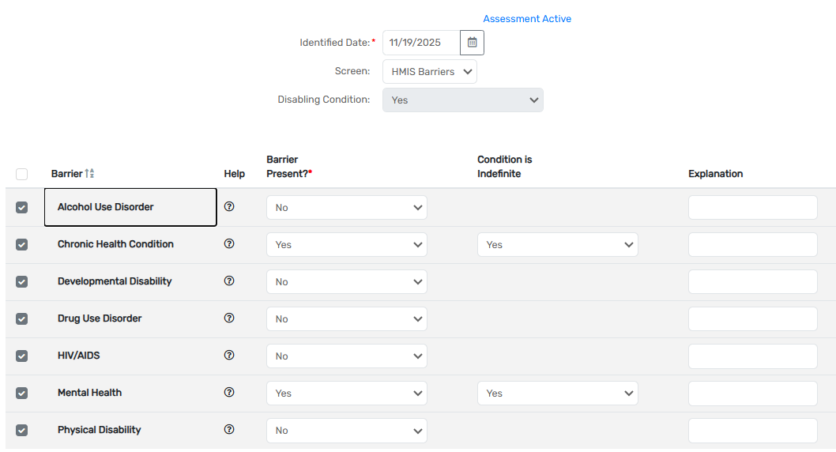
barriers
  If Disabling Condition is Yes, please indicate which kind of condition is present.

Slide 29
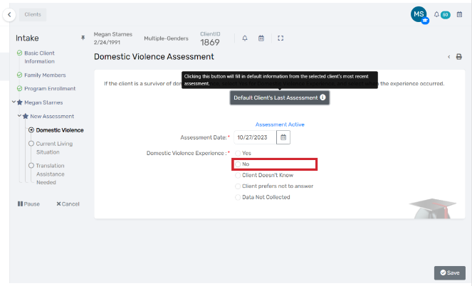
Domestic Violence Experience
  Are you here today because you’re trying to get away from an unsafe situation at home?

Slide 30
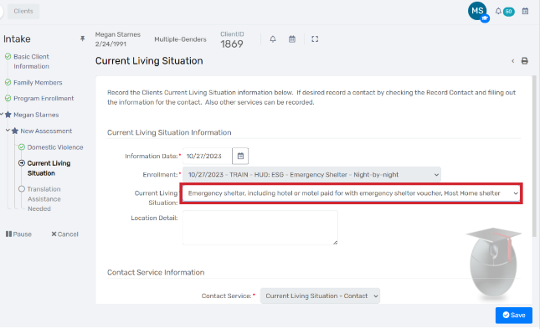
Current living situation
  Where are they staying tonight – shelter, you don’t even have to ask!

Slide 31



4.12 Current Living situation
Impact on chronicity
  For many neighbors, this enrollment in IWS may be the only time they are connected to our homeless response system.
    Housing programs are encouraged to use HMIS records to determine a client’s chronicity
    Your data impacts a client’s ability to be housed with certain programs
  The months where we engage these clients at IWS will count toward their eligibility for certain housing assistance programs if/when we connect them to our Coordinated Access System.
  Homelessness documented for chronicity using IWS record
CLS
CLS
  Homelessness NOT documented by IWS records

Slide 32
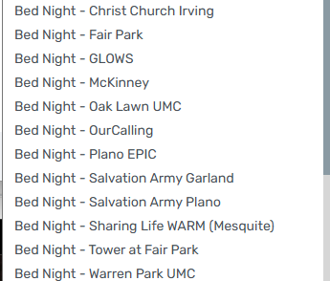
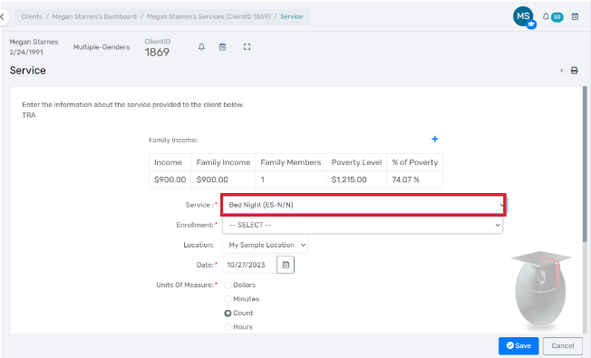
Bed Night Services
  Separate from the enrollment – you must navigate to it after intake
Steps
  Click “Add New Service”
  Choose IWS Enrollment
  Confirm Date
  Select “Bed Night – Your Site”

Slide 33
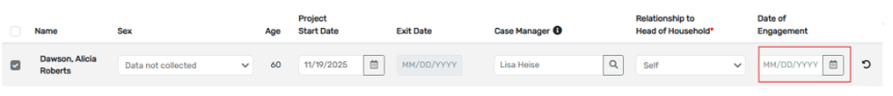
Date of engagement
  This element is required if a housing discussion occurred.

Slide 34
Project exit date
  When the enrollment is exited, the Exit Date will populate.

Slide 35

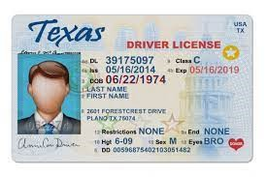

Document Collection – if/when it makes sense
  Take pictures of critical documents and upload to Client Files
Birth Certificates
Drivers' licenses
Social Security cards
  Also offering the opportunity to save a copy of your ID documents
  It’s okay if you don’t have them / not required for entry to IWS
  Documents will be visible to other service providers
  If you’re connected to permanent housing in the future, this could assist with intake into that program

Slide 36
Questions?

