Slide 1
Dallas Deflects
John Creuzot
Dallas County Criminal District Attorney

Slide 2
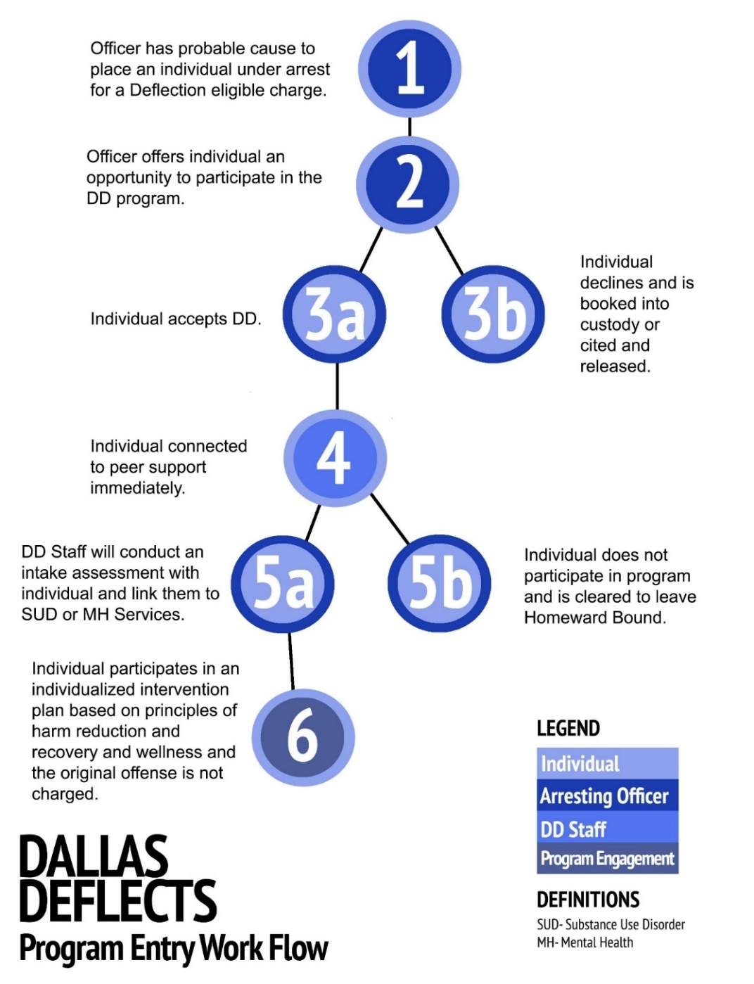
Dallas Deflects
What?
A community-based diversion program that provides law enforcement officers an alternative to arresting individuals who suffer from mental illness and have committed non-violent misdemeanor offenses. Allows officer to return to beat within 10-15 minutes.
How?
Provides clients a trauma-informed case management plan, where the client receives a wide range of community-based health and social services.

Slide 3
Why Do We Need Dallas Deflects?
Mr. A
Total Number of Arrests (Dallas Co. since 1999) | 63
Number of Criminal Trespass Charges | 46
Number of Days on Behavioral Observation | 1,214
Total Number of Days Sentenced For Criminal Trespass | 1,500
*Data from Dallas County Adult Information System (AIS)
Ms. B**
Total Number of Arrests (Dallas Co. since 1996) | 58
Number of Criminal Trespass Charges | 42
Number of Days on Behavioral Observation | 719
Total Number of Days Sentenced For Criminal Trespass | 1,835
** Most recently Back in Jail 7/22/2020

Slide 4
Dallas Deflects Capacity
Homeward Bound wing for DD can house 16 individuals at any given time
Projected intake ~2 individuals per day/5 days a week /520 individuals per year (eventually go 24/7)
Goal – engage individuals in wrap-around services so they can transition from DD to detox, residential substance use (at HB) or stable housing as soon as practical
Salvation Army will be second location when new facility finished - allow drop offs at a deflection center in North Dallas

Slide 5
Current Status
Homeward Bound – empty wing to remodel for the Center
Parkland – provide medical services ($990,000)
NTBHA – provide mental health services ($1.4 mil)
Dallas County recently committed to covering Cost for build out of wing in Homeward Bound – approx. $1 million
Ernst & Young partnering to provide cost benefit analysis for the project
Downtown Dallas Inc. partnering to assist with support from local downtown businesses
Remaining:
  Security for the Center – approx. $250,000/yr (24/7)
  Individual Residential Room Finish Out – this is where local corporations and organizations can collaborate on the project to “sponsor a room”

Slide 6
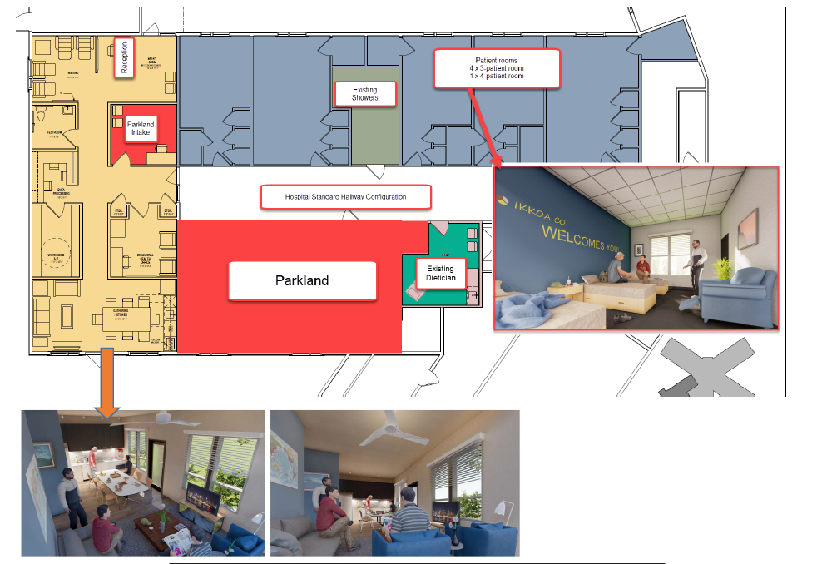
Layout & Interior Renderings

Slide 7
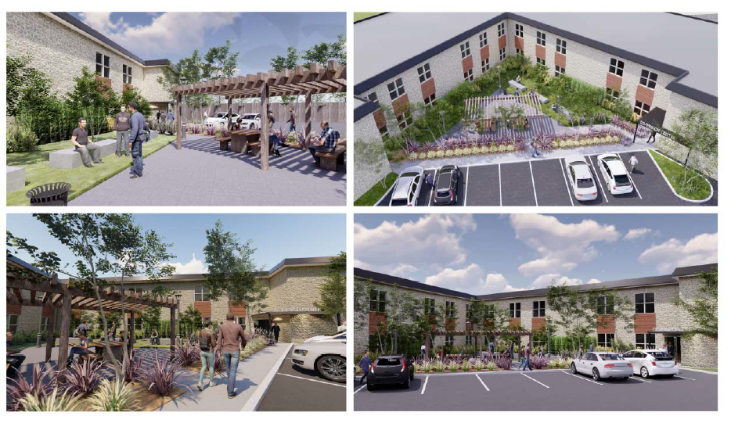
Outside Area and Drop Off

Slide 8
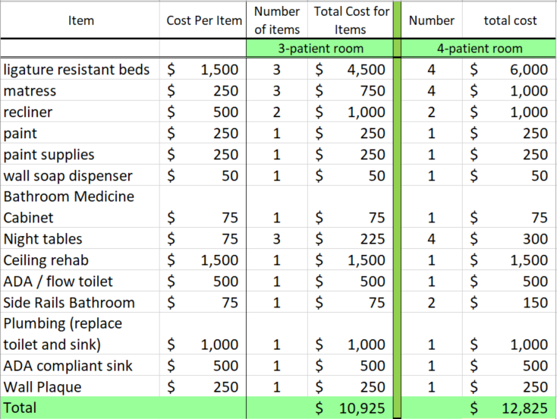
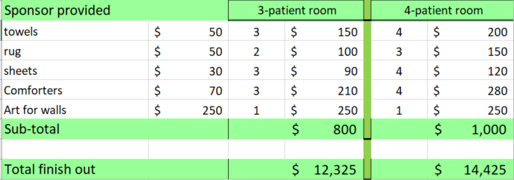
Sponsor a
Client Room?

Slide 9
Question & Answer
For brochures or further information on how you can assist with Dallas Deflects please contact: Julie.Turnbull@dallascounty.org

