Slide 1
FY 2021-22
ESG Grant
CoC General Assembly
January 26, 2021
Kevin Oden, Director (I)
Office of Homeless Solutions
City of Dallas

Slide 2
Presentation Overview
Purpose
OHS Background
Provide information regarding the Emergency Solutions Grant (ESG)
Obtain Continuum of Care feedback for FY2021-22 Budget Recommendations
Resident Participation & Doing Business with City

Slide 3
Purpose
Provide information on FY2021-22 Emergency Solutions Grant
Solicit feedback from Continuum of Care General Assembly for the FY 2021-22 Annual Action Plan and Budget
Share City’s planning approach for ESG

Slide 4
City of Dallas - Office of Homeless Solutions
Mission
To positively impact quality of life in the City of Dallas through innovative, collaborative, and comprehensive solutions for homelessness
Target Populations
Unsheltered experiencing homelessness
Persons residing in emergency shelters
Persons who are at risk of homelessness
Veterans, seniors over age 55, youth including ages 18-24, disabled persons, or families with children who are experiencing homelessness
Persons fleeing from domestic violence

Slide 5
City of Dallas – Office of Homeless Solutions
Key Priorities
Preventing homelessness
Identify at-risk populations and targeting solutions that are sensitive to the special needs of those populations
Increase educational, skill building, and employment opportunities
Identify and address specific factors that contribute to homelessness
Protecting persons experiencing homelessness
Employ innovative, low barrier, person-centered, measurable, and high-quality services through the homeless response system of care
Support the health, safety, and quality of life for persons experiencing homelessness
Reduce recidivism back into homelessness
Promoting affordable housing solutions
Address the inadequate supply of affordable housing units through creative, non-traditional, and sustainable housing solutions
Equip individuals and families with the tools to be successful at obtaining and maintaining housing
Partnering to maximize resources
Foster a comprehensive, coordinated, system-led response that engages the community, encourages partnerships, and blends public and private funding focused on performance

Slide 6
Emergency Solutions Grant
ESG is part of the City of Dallas Consolidated Plan
Five-Year Plan (10/1/19 to 9/30/24)
Annual Action Plans
City’s Grant Application to HUD
City’s Consolidated Plan includes four grants:
Community Development Block Grant (CDBG)
HOME Investment Partnerships Program (HOME)
Emergency Solutions Grant (ESG)
Housing Opportunities for Persons with AIDS (HOPWA)

Slide 7
Emergency Solutions Grant
Created in 1987 by Stewart B. McKinney Homeless Assistance Act
The Department of Housing & Urban Development (HUD) is the administering agency
Primary focus is to assist homeless individuals and families with services
Engage homeless individuals and families living on the street
Improve the number and quality of emergency shelters for homeless individuals and families
Help operate emergency shelters
Provide essential services to shelter residents
Rapidly re-house homeless individuals and families, and
Prevent families/individuals from becoming homeless
Household income cannot exceed 30% of the Area Median Family Income (for Rapid Re-Housing at annual assessment and for Homeless Prevention)

Slide 8
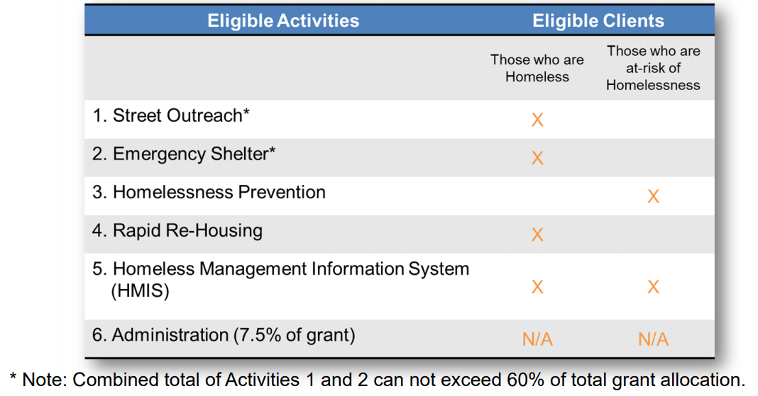
ESG Allowable Expenses

Slide 9
Current FY20/21 ESG Budget
Program Category | Amount | Percent
Emergency Shelter | $512,680 | 39.7%
Street Outreach | $77,682 | 6.0%
Homelessness Prevention | $246,086 | 19.1%
Rapid Re-Housing | $366,000 | 28.3%
HMIS | $0 | 0.0%
ESG Administration | $89,000 | 6.9%
Total | $1,291,488 | 100.0%

Slide 10
Previous Budget Comparisons
Program Category | FY18-19 (amended) | % of Grant | FY 19-20 (amended) | % of Grant | FY 20-21 (amended) | % of Grant
Emergency Shelter | $505,854 | 42.0% | $495,052 | 39.4% | $512,680 | 39.7%
Street Outreach | $46,679 | 3.9% | $81,362 | 6.5% | $77,682 | 6.0%
Homelessness Prevention | $145,261 | 12.1% | $155,261 | 12.3% | $246,086 | 19.1%
Rapid Rehousing | $407,762 | 33.9% | $436,000 | 34.7% | $366,000 | 28.3%
HMIS | $8,798 | 0.7% | $0 | 0.0% | $0 | 0.0%
Administration | $89,520 | 7.4% | $89,000 | 7.1% | $89,000 | 6.9%
Total | $1,203,874 | 100.0% | $1,256,675 | 100.0% | $1,291,448 | 100.0%

Slide 11
Additional ESG Information
ESG must be matched dollar for dollar
HUD will allow cash or donated materials/services
Funds must be expended within 24 months
Annual Reports are required
Partners must enter client data in HMIS with performance measured quarterly
Units for placement must meet minimum housing standards and shelters must meet minimum shelter standards
Inspections are required
Rent paid for clients must be reasonable
Measured against market rates
All clients receive some level of case management services
Maximum timeframe for assistance is 24 months (Rapid Re-Housing and Homeless Prevention)
Budget allocations consider homeless priorities for the Continuum of Care (CoC) as set forth in the Consolidated Plan

Slide 12
Resident Participation
Residents can participate in the Consolidated Plan budget development process by:
Mail
Mail comments to:
Online
Take Community Survey Online at: http://dallascityhall.com/departments/budget/communitydevelopment
Verbal
Comment during Virtual Public Meetings
Email comments to: ofscommunitydevelopment@dallascityhall.com
Speak at Community Development Commission monthly meetings or City Council public hearings
Call 214-670-4557 to make a comment to Budget & Management Services
Scroll down to “Survey” link under FY2021-22 CONSOLIDATED PLAN BUDGET
City of Dallas
Budget & Management Services/Grant Administration
1500 Marilla Street, 4FS
Dallas, TX 75201
Comments received by February 24 will be considered for the FY 2021-22 Annual Action Plan Budget
Submission of a comment does not guarantee funding

Slide 13
Doing Business with the City
Register on-line at:
https://dallascityhall.bonfirehub.com
Contact the Office of Procurement Services at:
214-670-3326
askprocurement@dallascityhall.com
Notification of upcoming Request for Bids (RFB) and Request for Proposals (RFP) are published quarterly on the Office of Procurement Services website. Current procurement opportunities are found at: https://dallascityhall.bonfirehub.com

Slide 14
Get Social with Us…
@dallascommdev

Slide 15
DISCUSSION

Slide 16
FY 2021-22
ESG Grant
CoC General Assembly
January 26, 2021
Kevin Oden, Director (I)
Office of Homeless Solutions
City of Dallas

